Slide 1
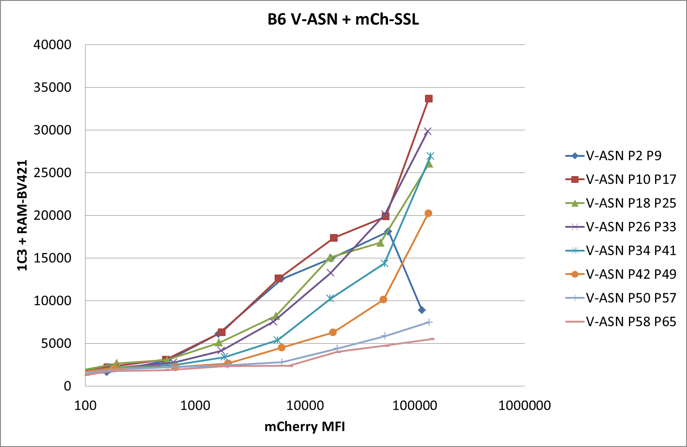
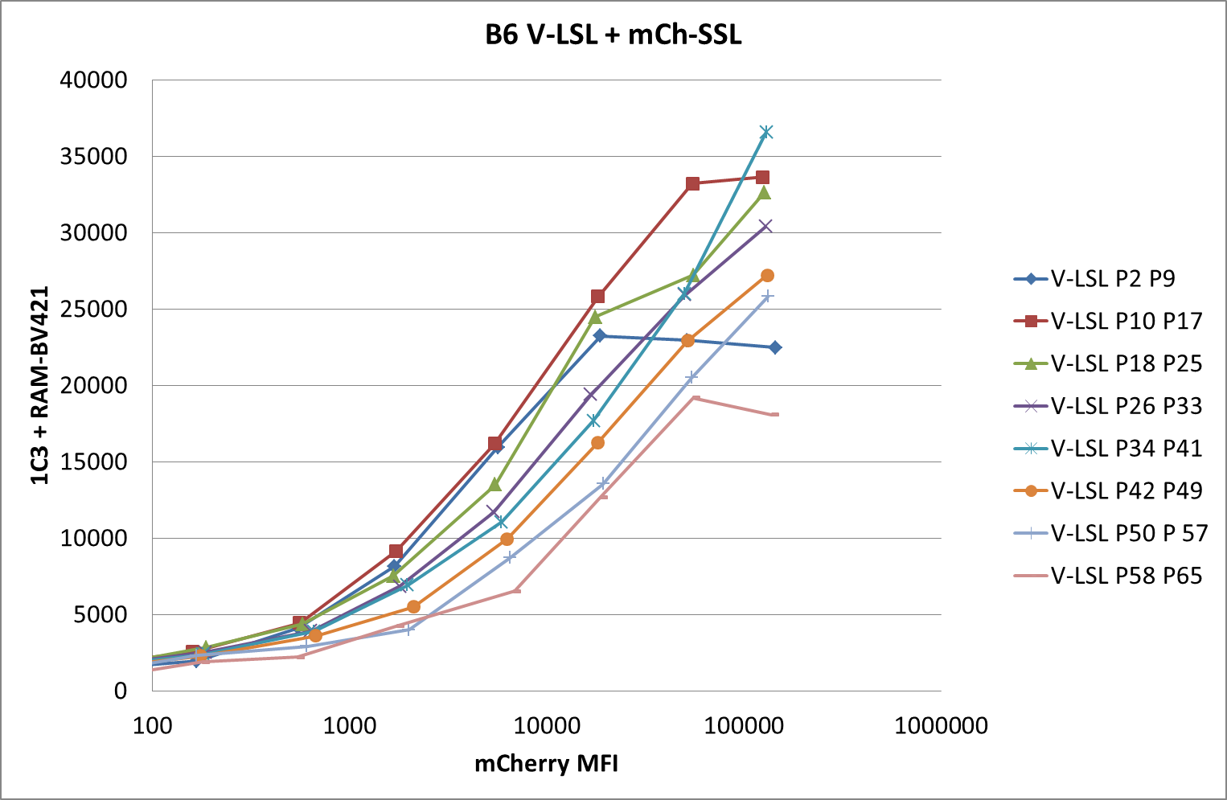
150318 pMHC competition
009
013
Notes:
Sent 13/08/2015

Slide 2
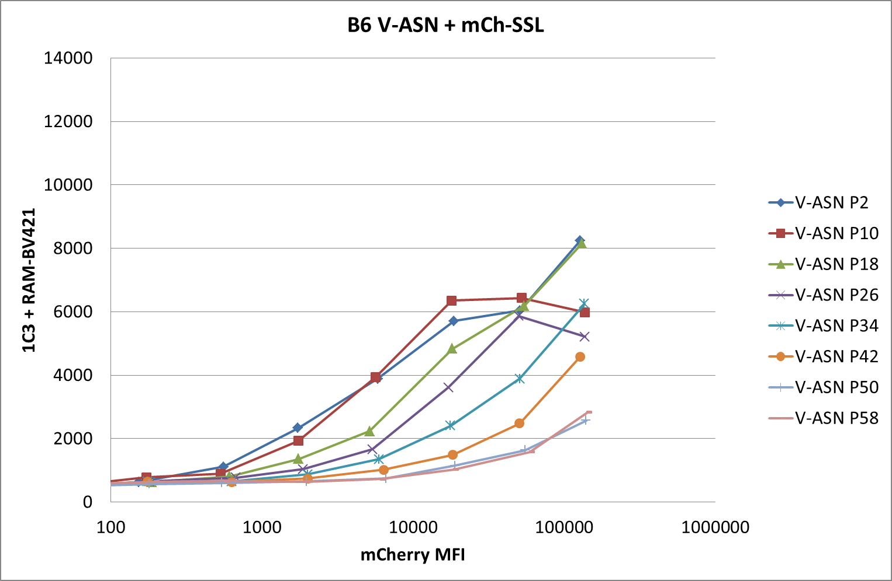
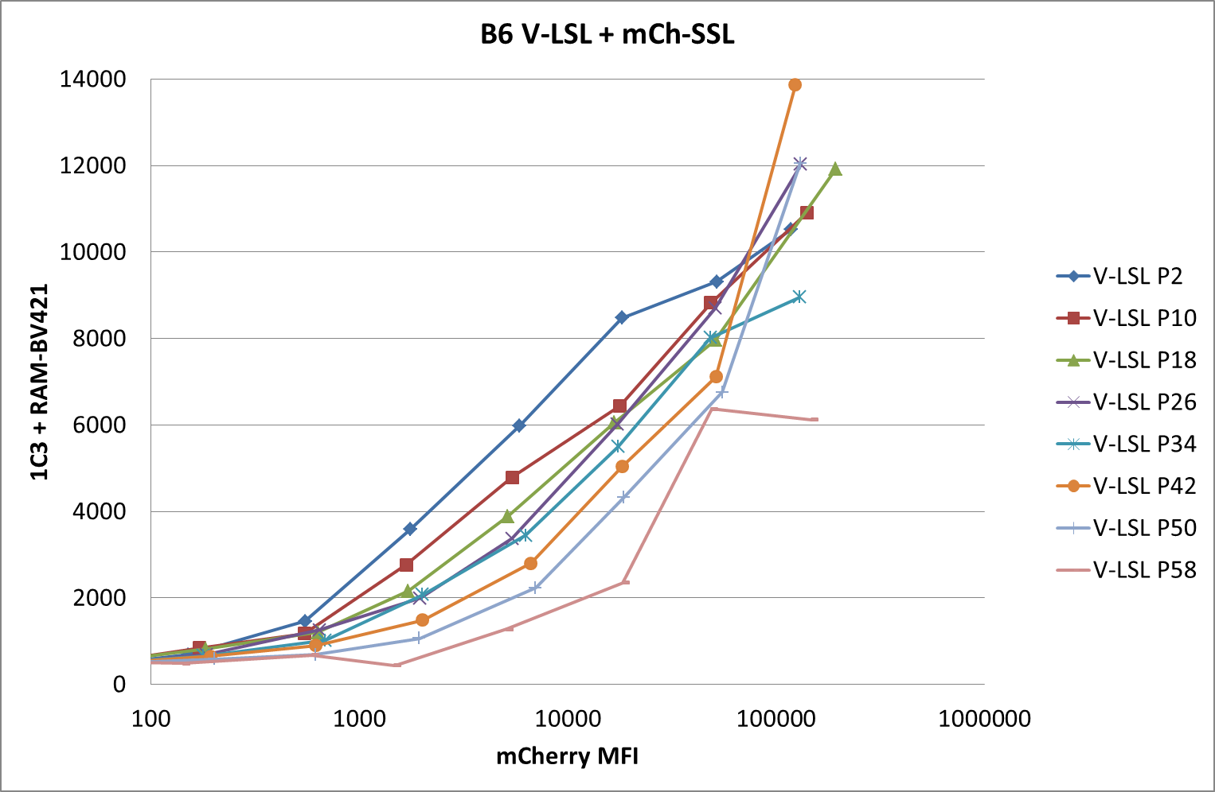
150325 pMHC competition
013
017
Notes:
Repeat of 150318: much lower MFIs but same results
Sent 13/08/2015

Slide 3
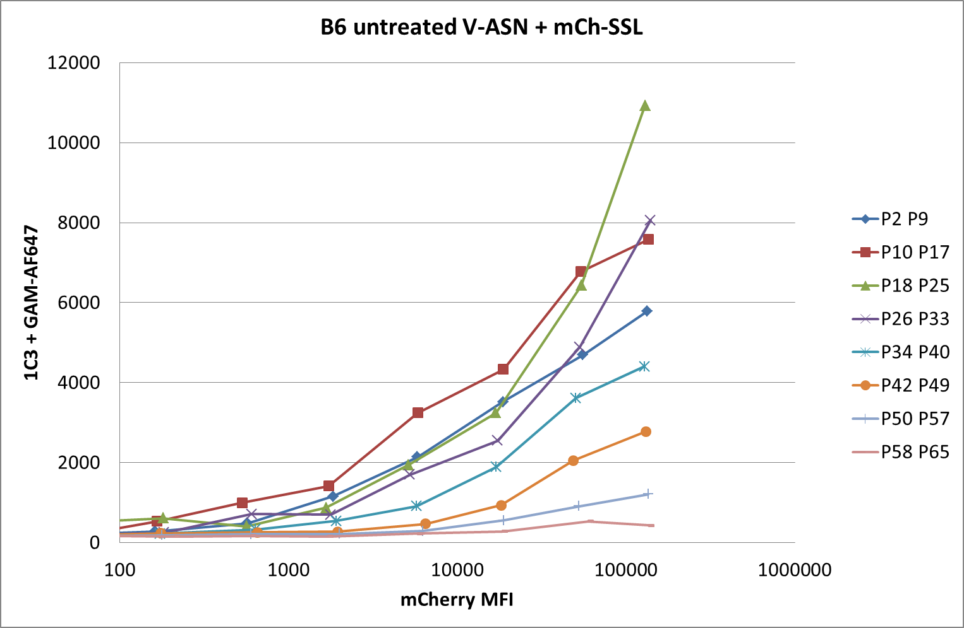
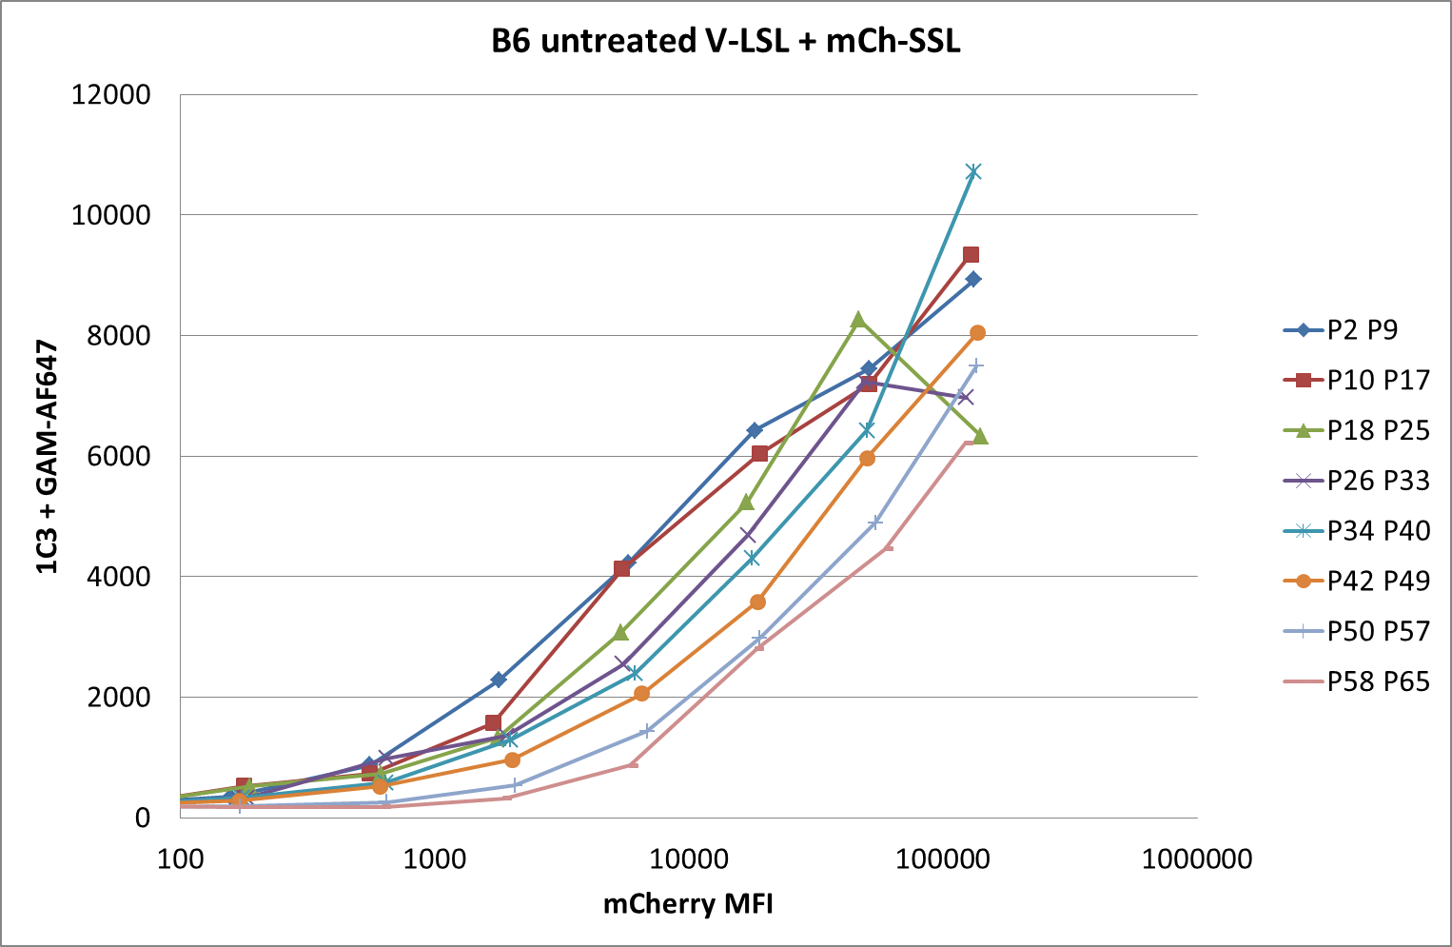
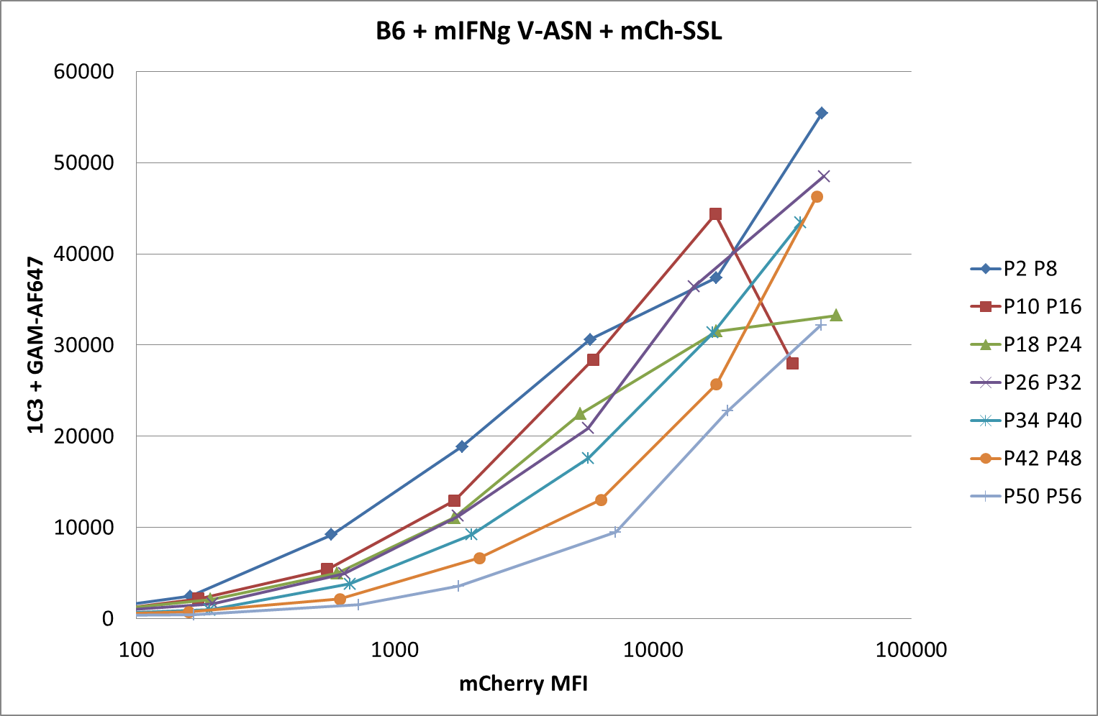
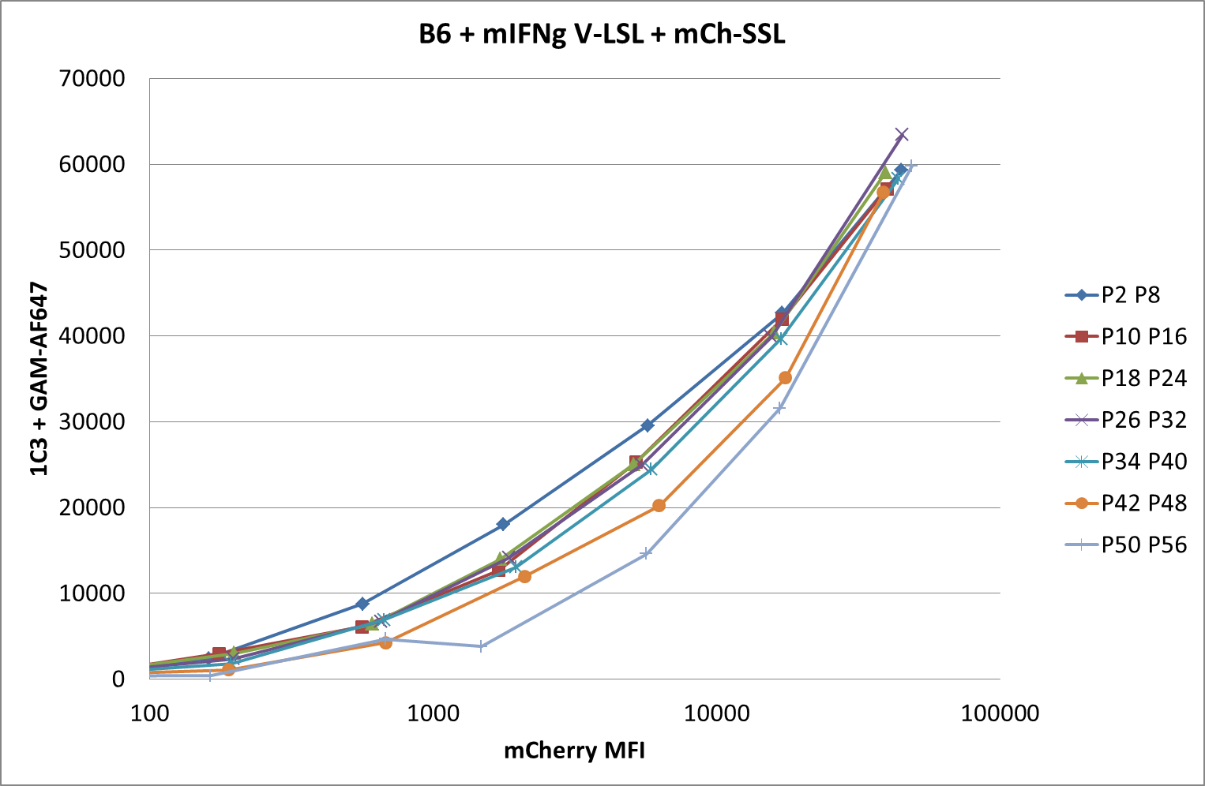
150401 pMHC competition
B6 fibroblasts +/- mIFNg
005
009
007
011
Notes:
Sent 09/06/2015

Slide 4
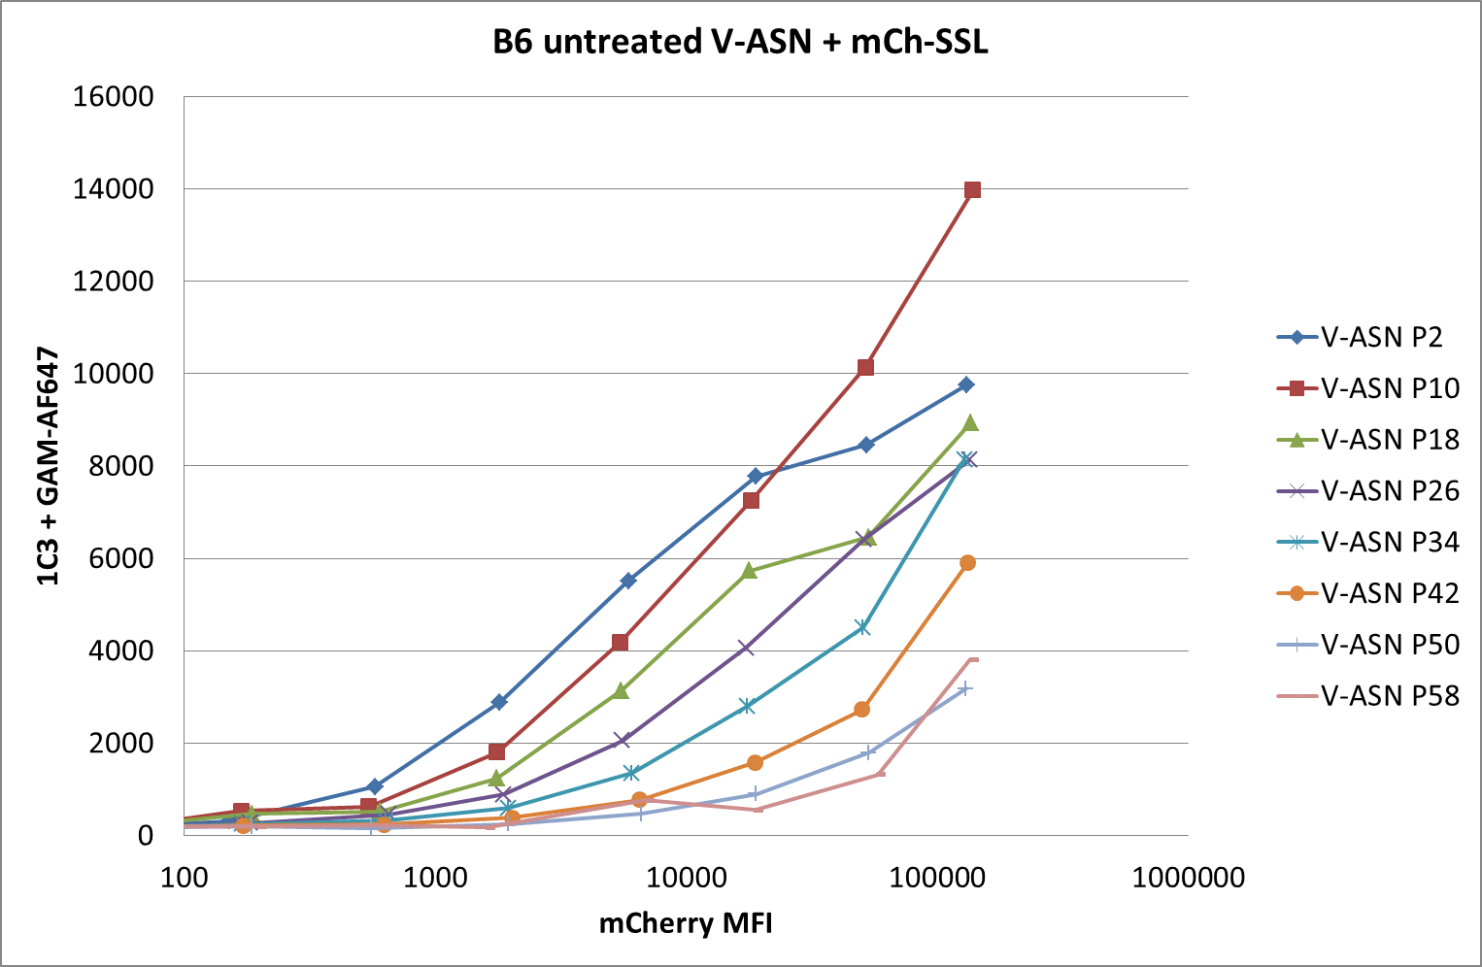
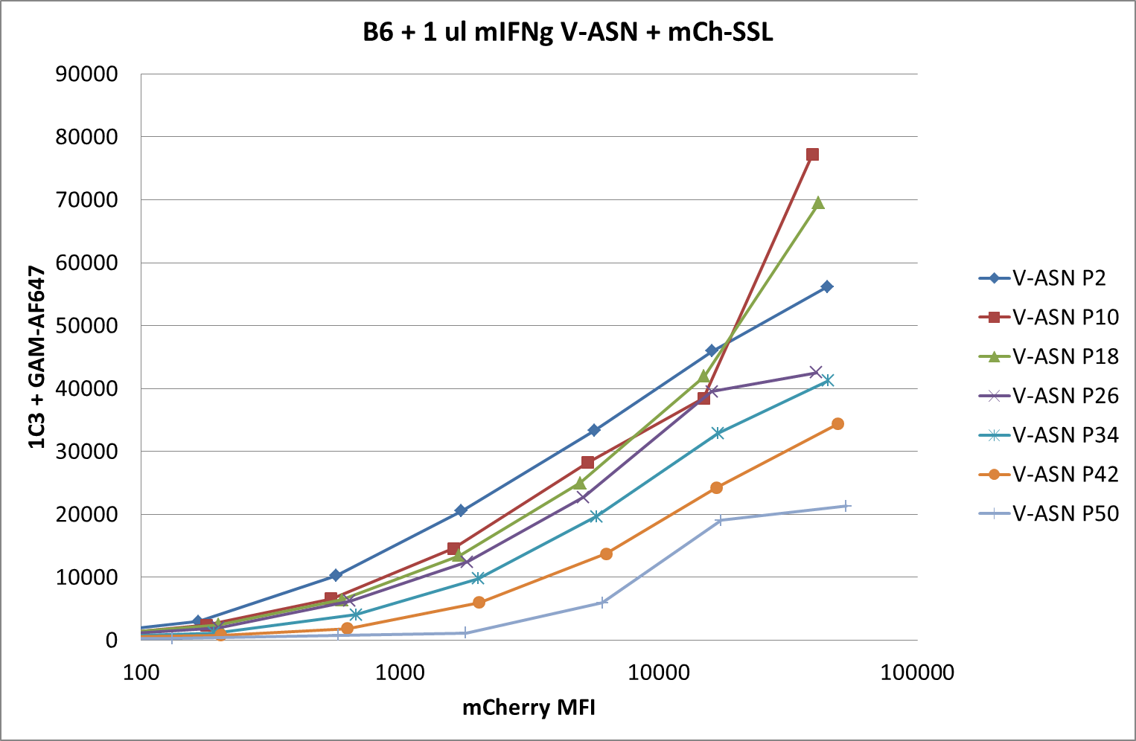
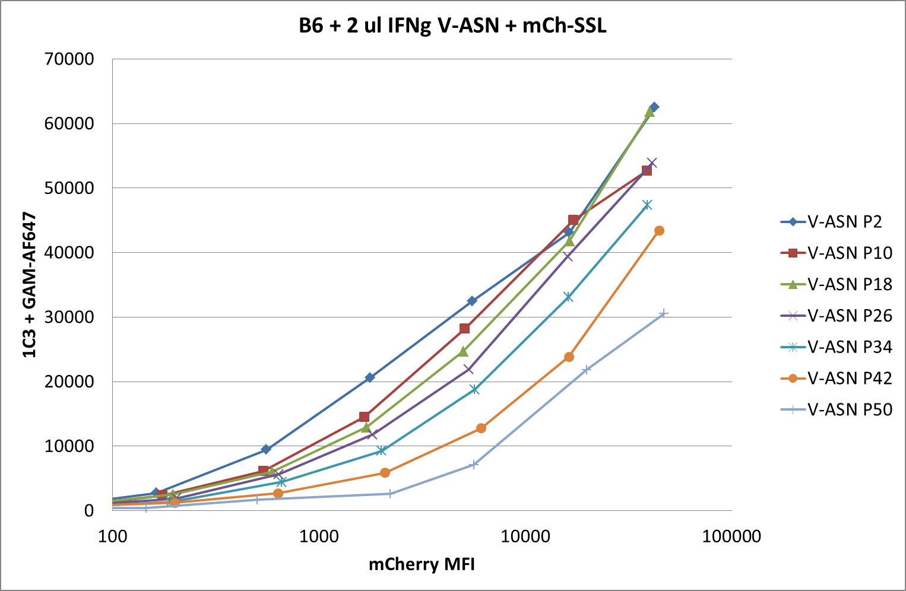
150422 pMHC competition
B6 fibroblasts +/- mIFNg
008
010
012
Notes:
Repeat of 150401, same results
Sent 09/06/2015

Slide 5
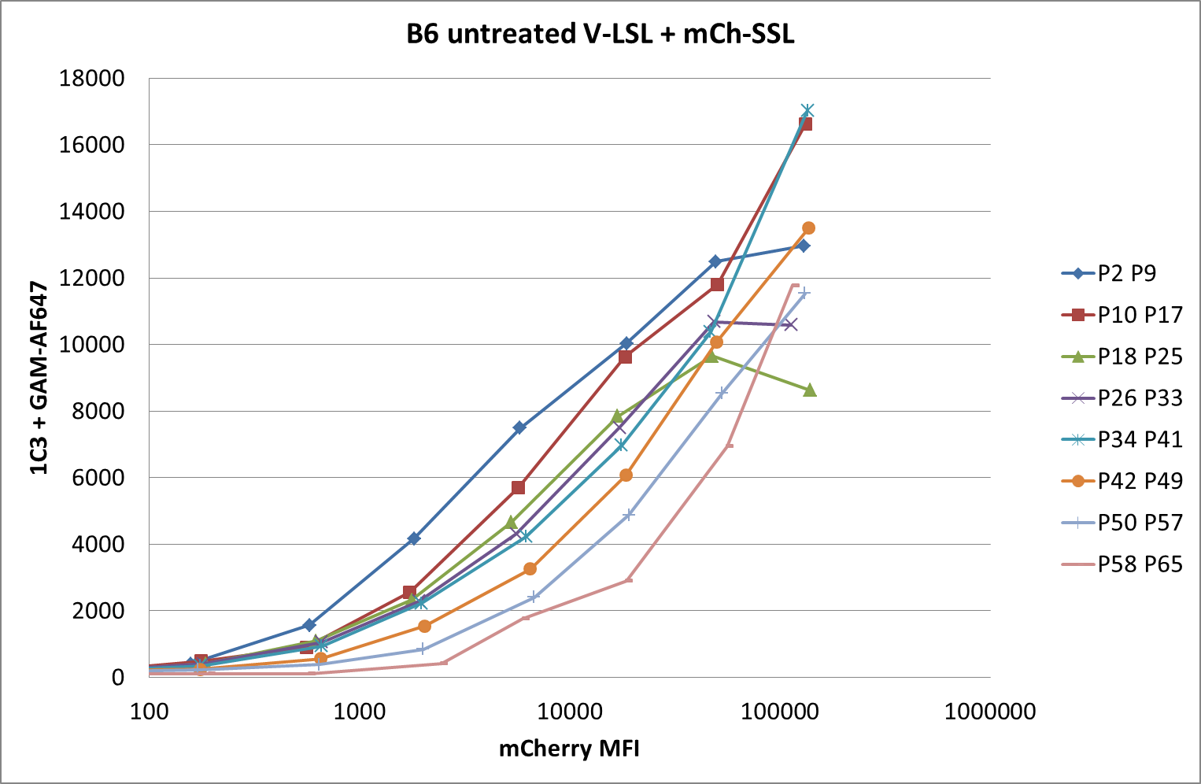
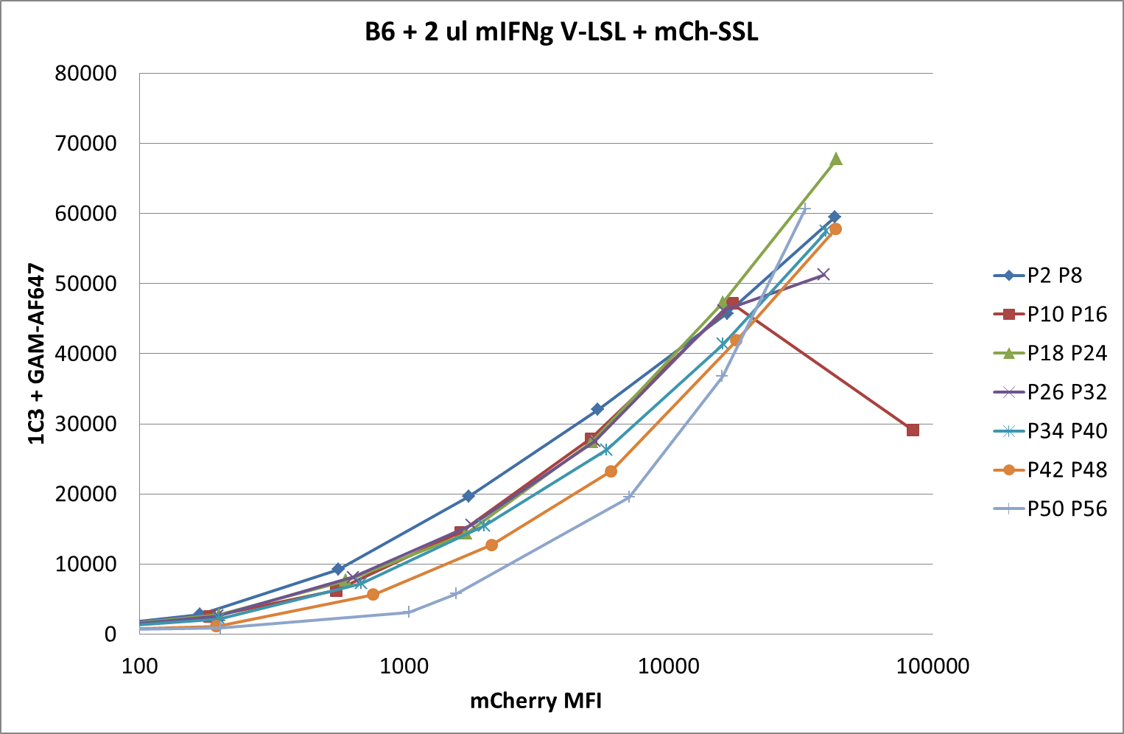
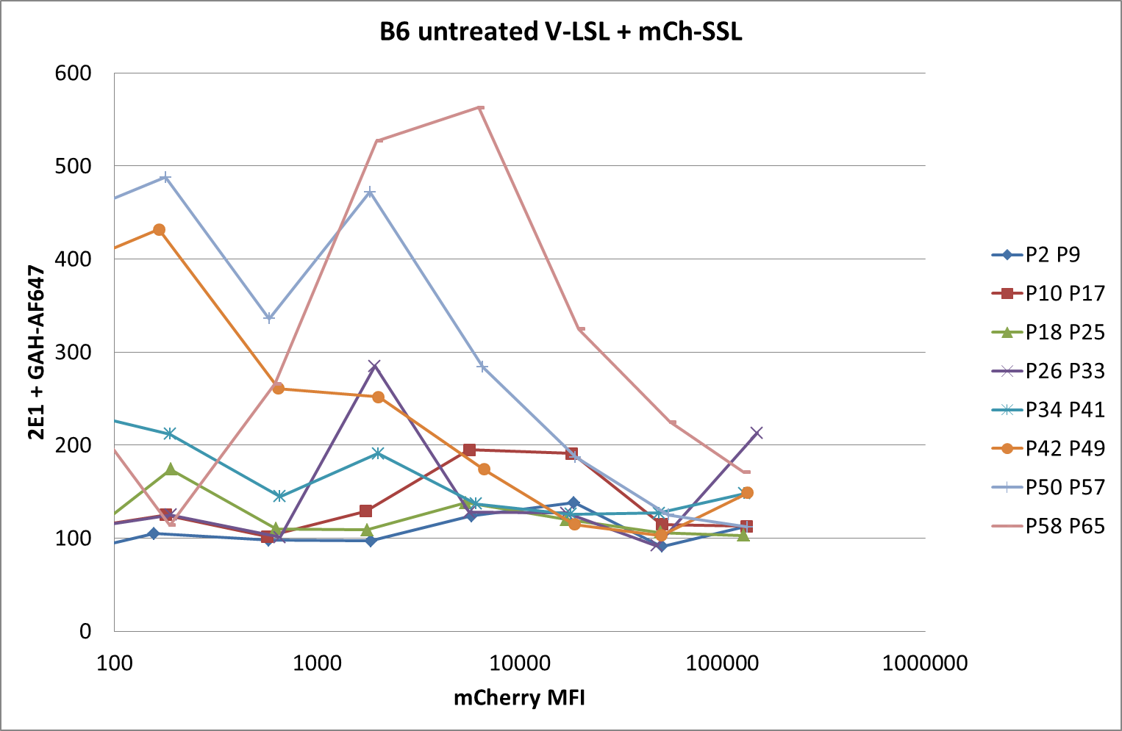
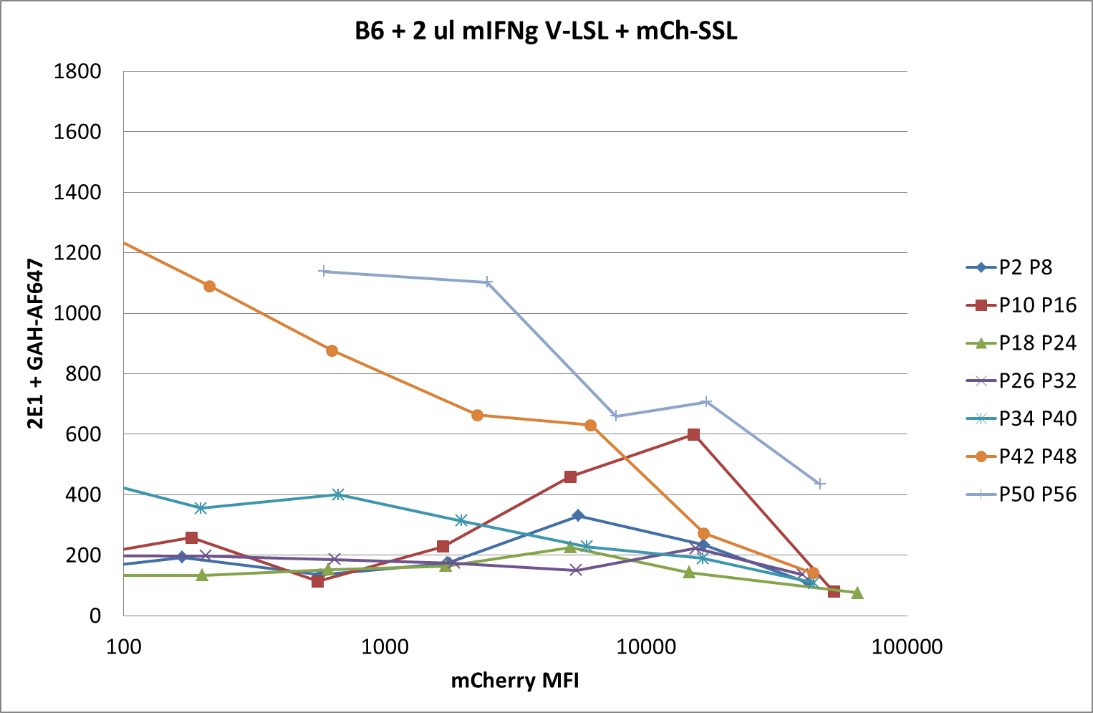
150422 pMHC competition
B6 fibroblasts +/- mIFNg
014
017
016
019
Notes:
Repeat of 150401 with 2E1 Fab staining in parallel (bottom graphs)
Sent 09/06/2015
Some LSL surface expression can be detected in untreated cells at the highest levels of Venus expression. After IFNg treatment LSL expression is much higher. Therefore IFNg treatment allows efficient surface expression of both peptides.

Slide 6
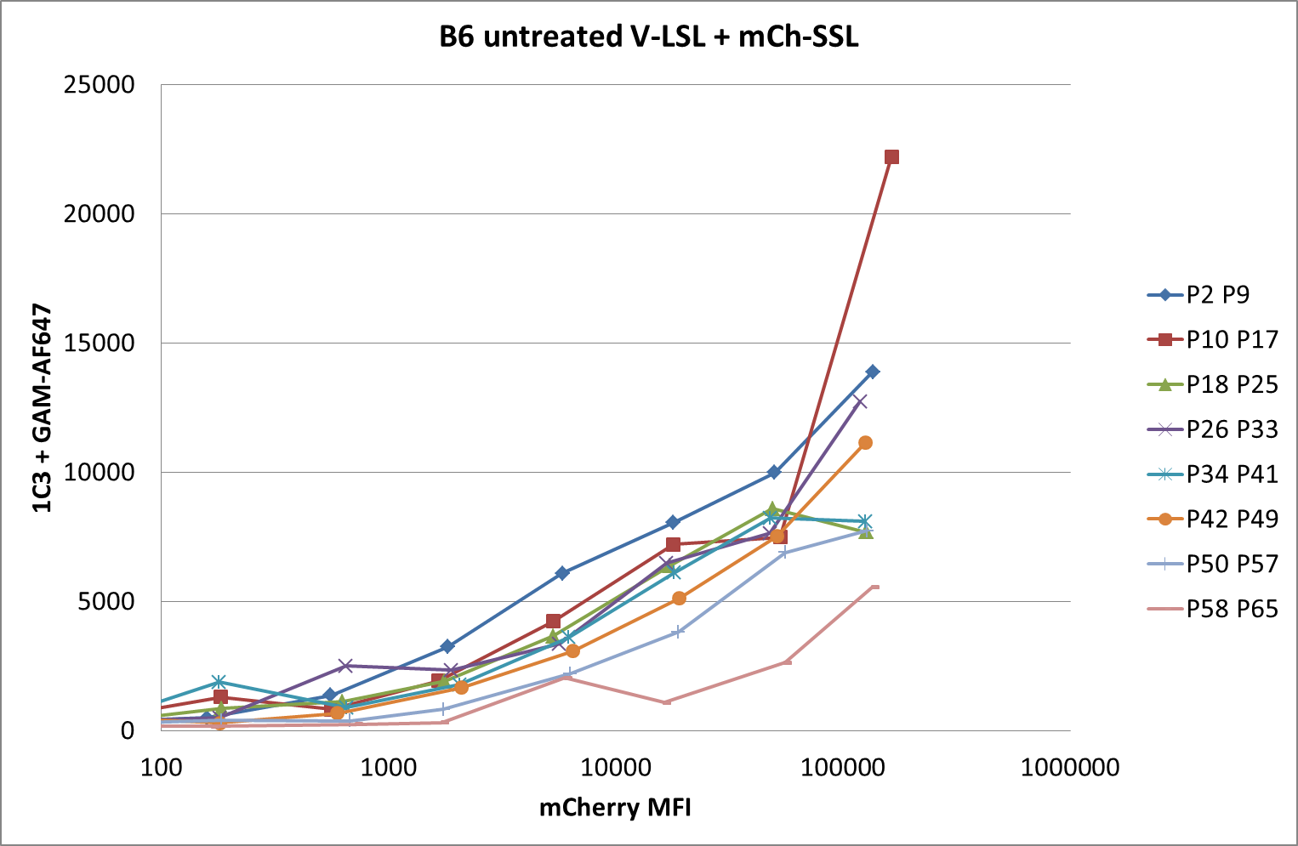
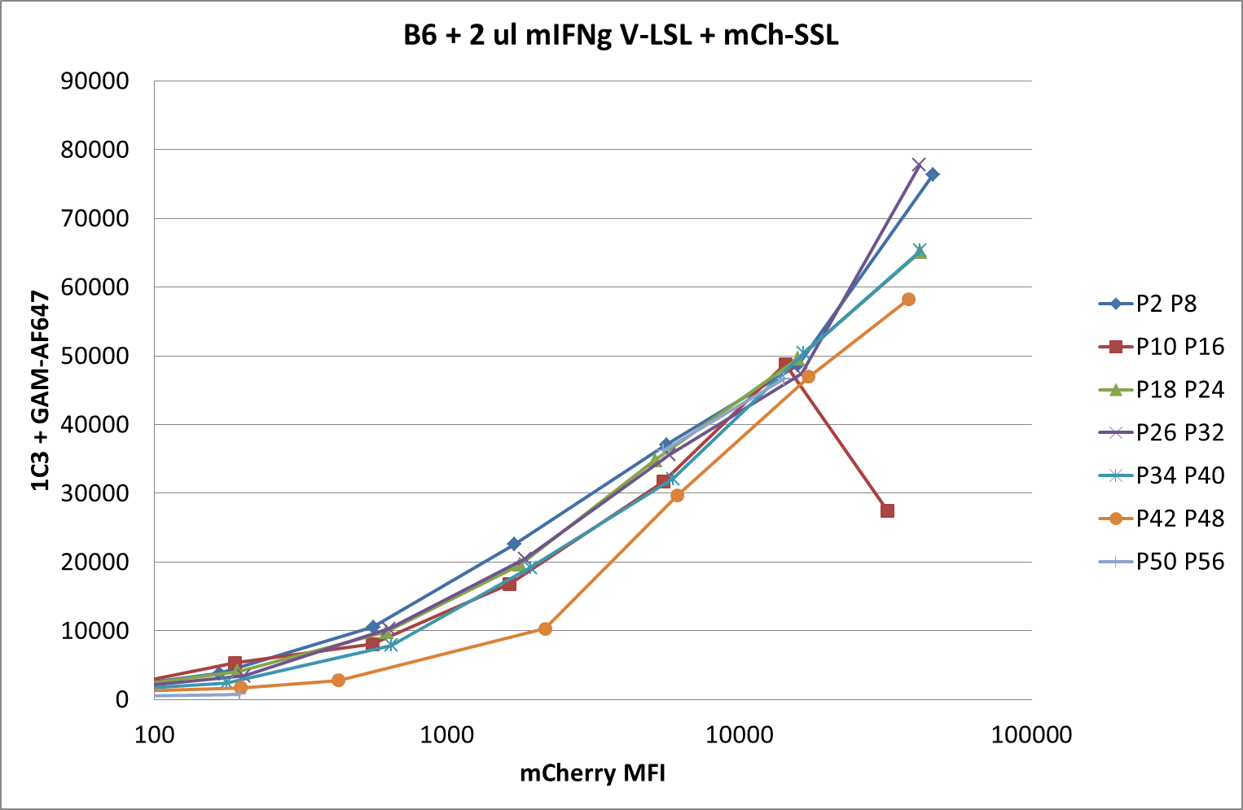
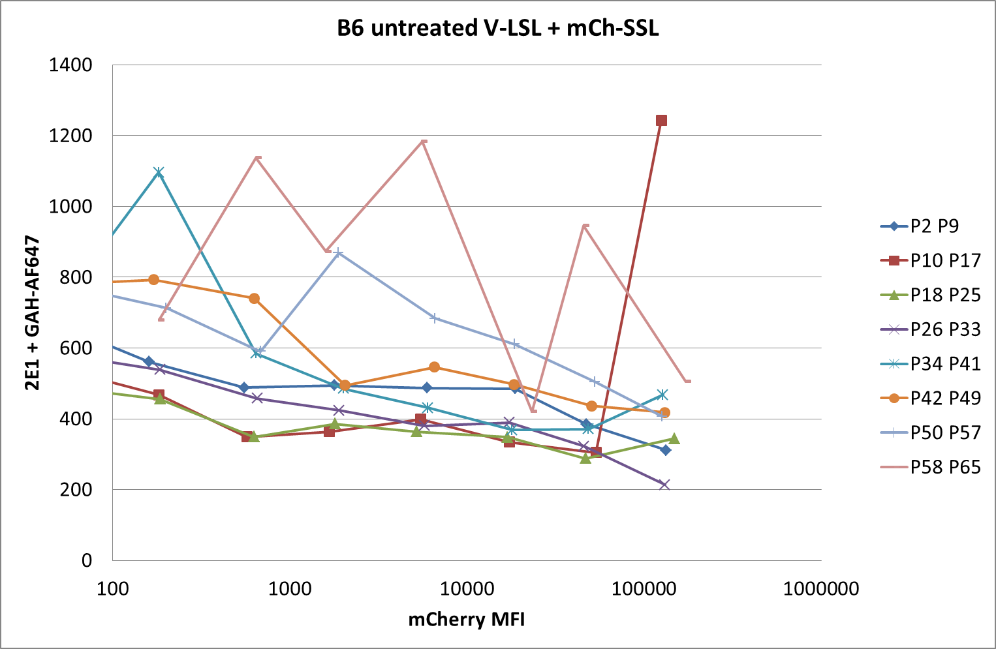
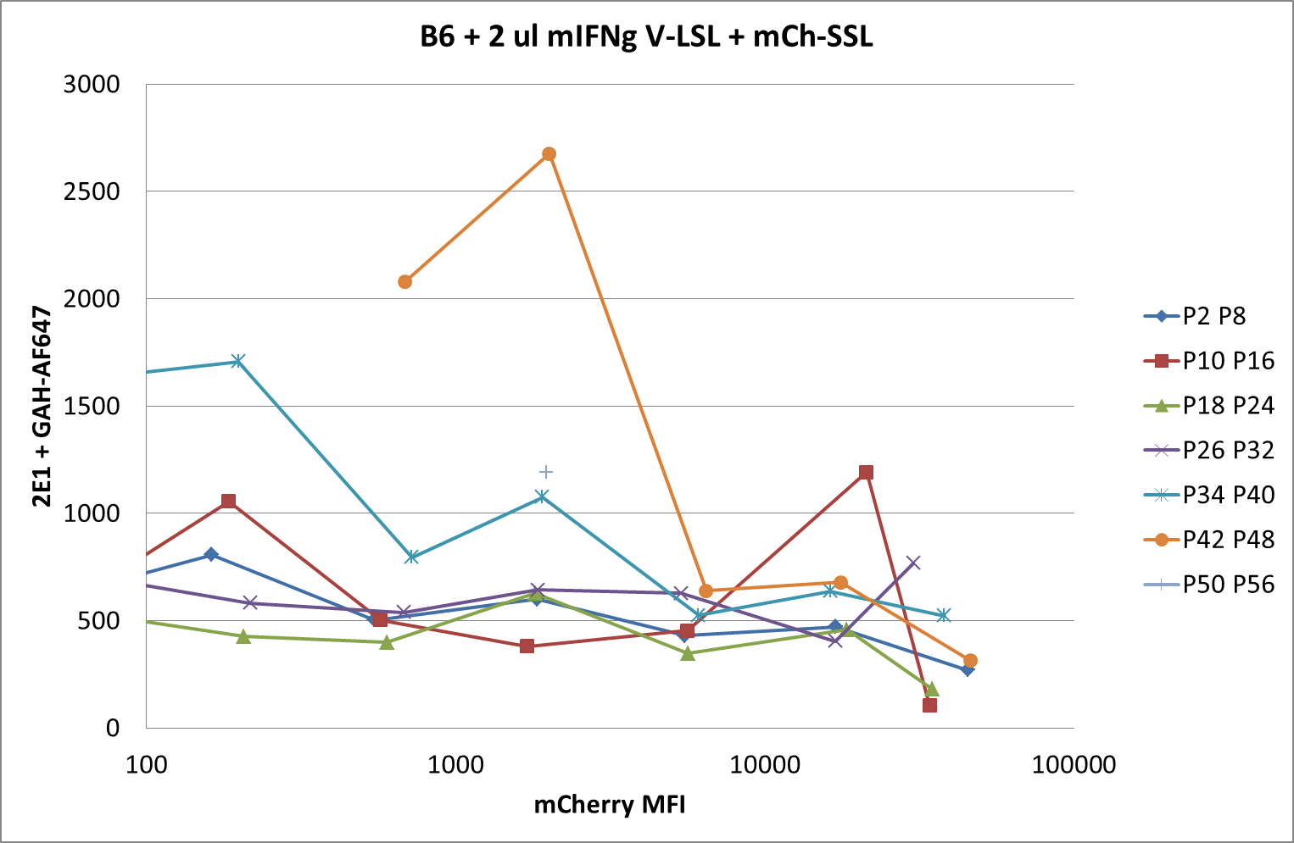
150507 pMHC competition
B6 wt fibroblasts +/- mIFNg
007
011
Not enough cells
009
013
Notes:
Transfection efficiency lower than usual
Sent 13/08/2015

Slide 7
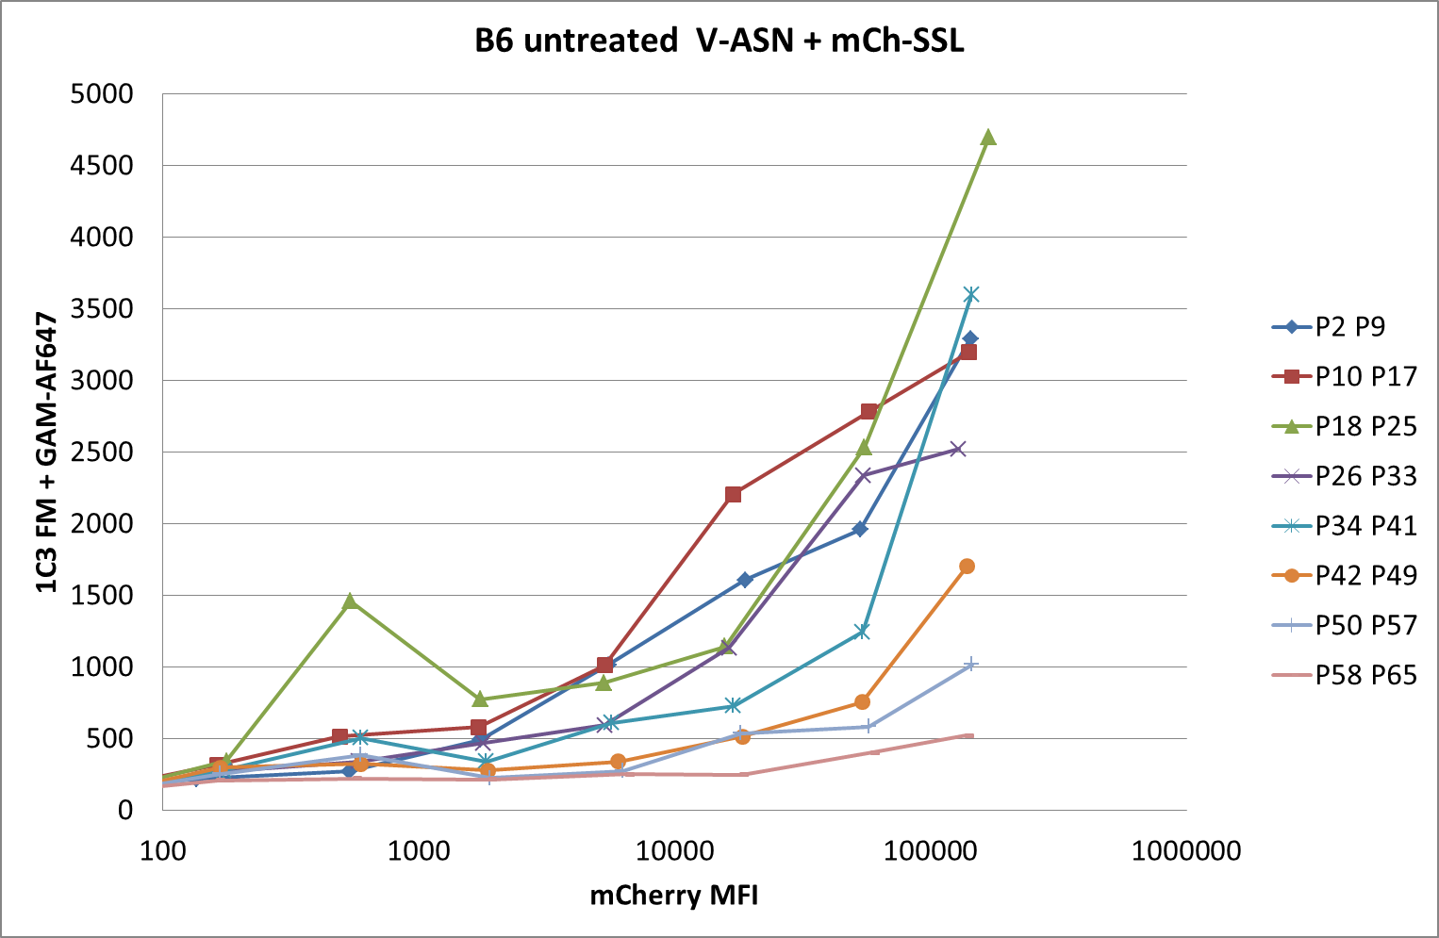
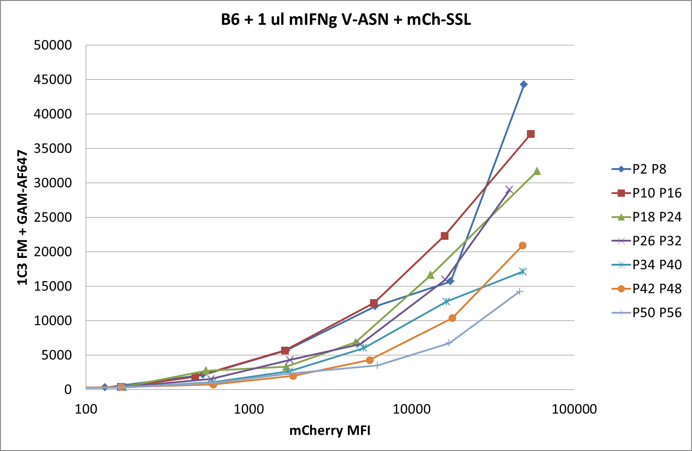
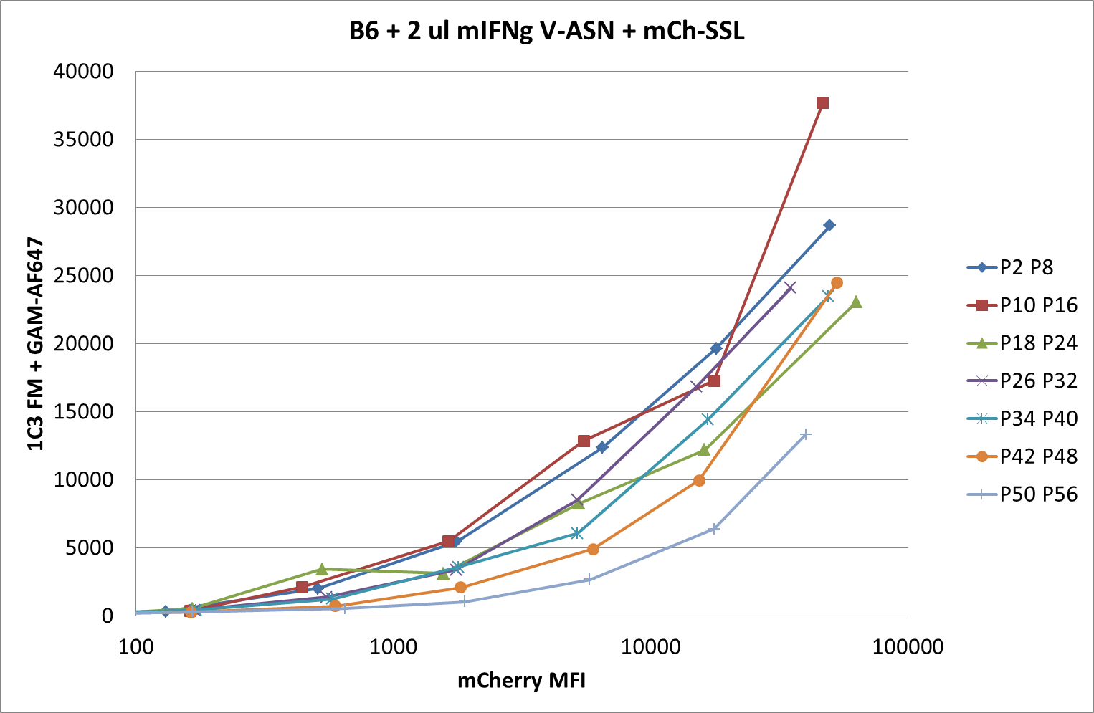
150520 pMHC competition
B6 wt fibroblasts +/- mIFNg
008
009
010
Notes:
Same with V-ASN instead of LSL
Sent 13/08/2015

Slide 8
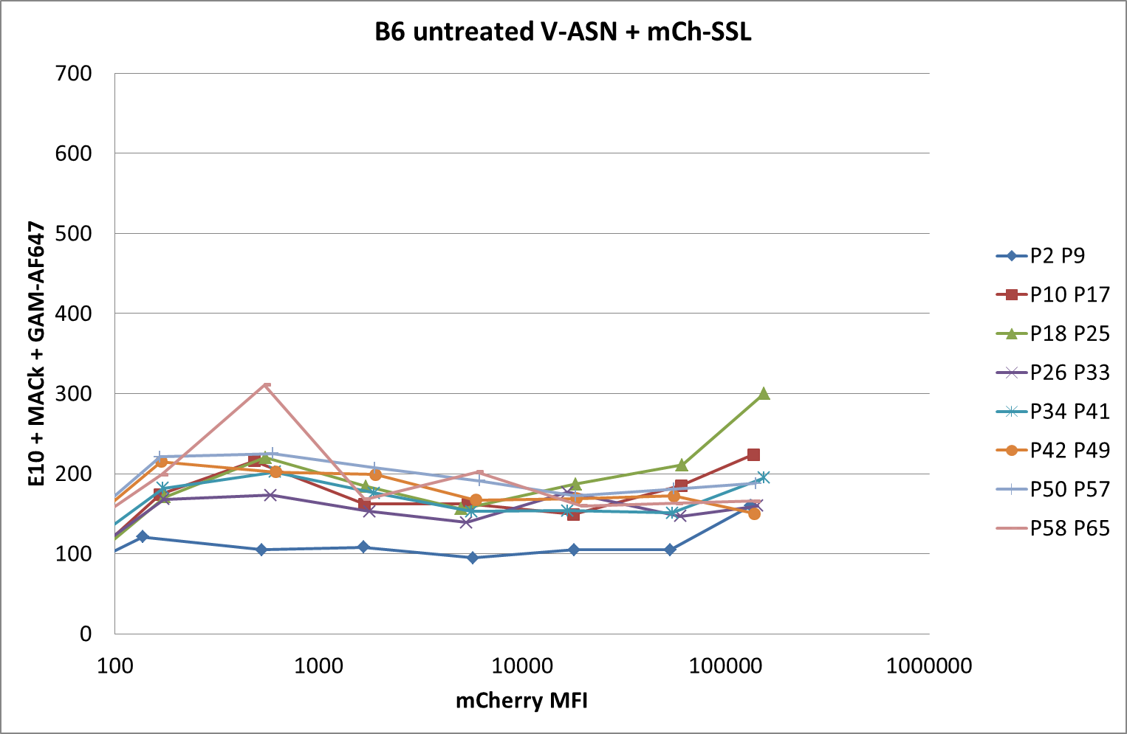
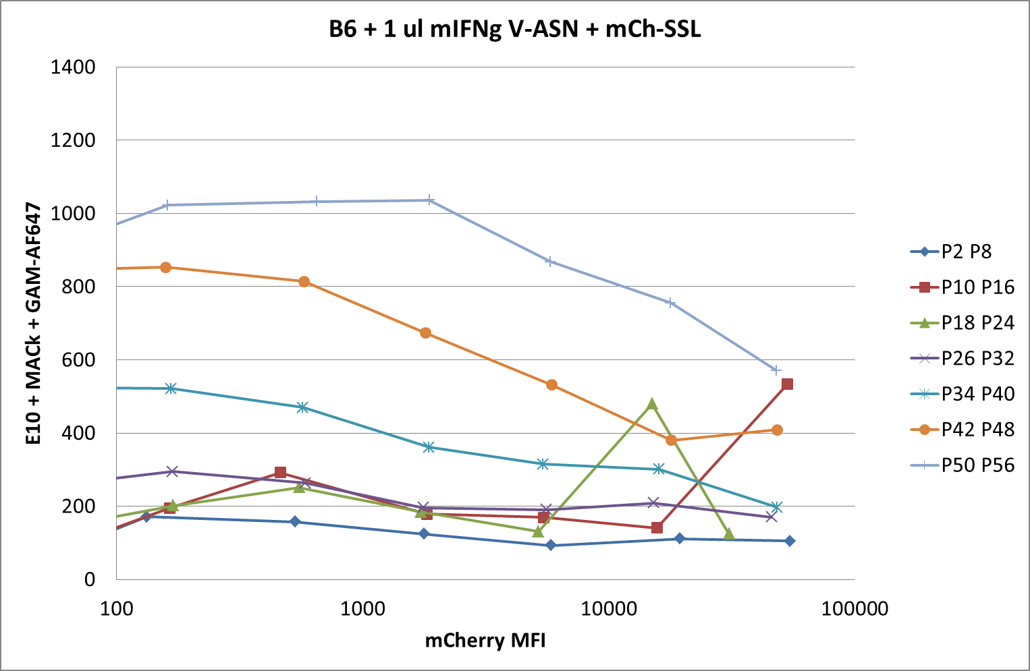
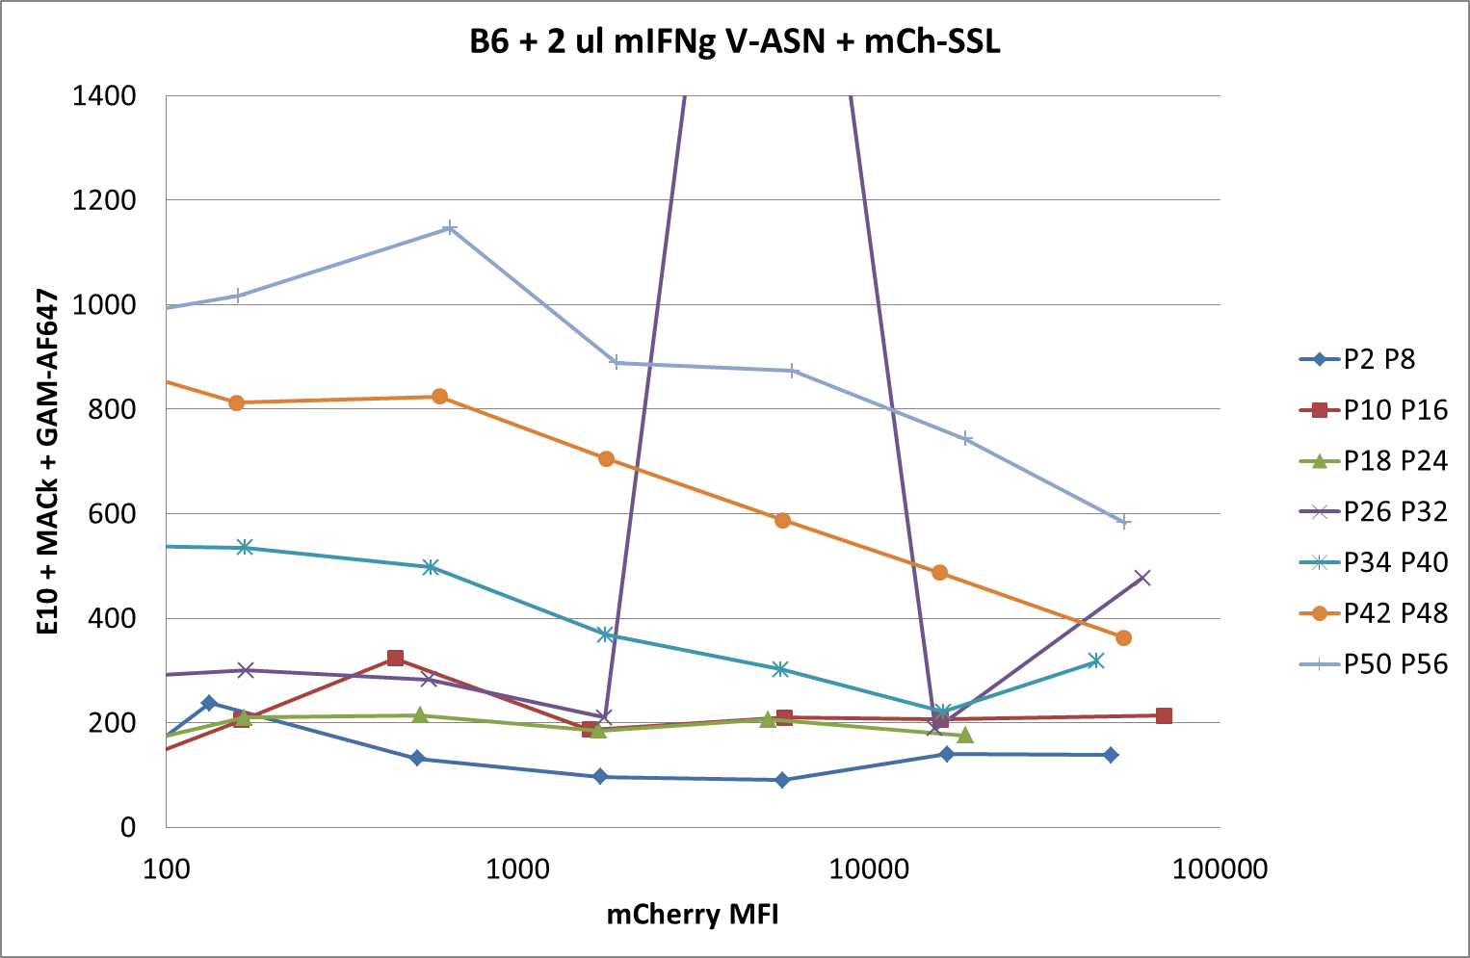
150520 pMHC competition
B6 wt fibroblasts +/- mIFNg
017
018
019
Notes:
ASN nicely detected in the presence of IFNg
Sent 13/08/2015

Slide 9
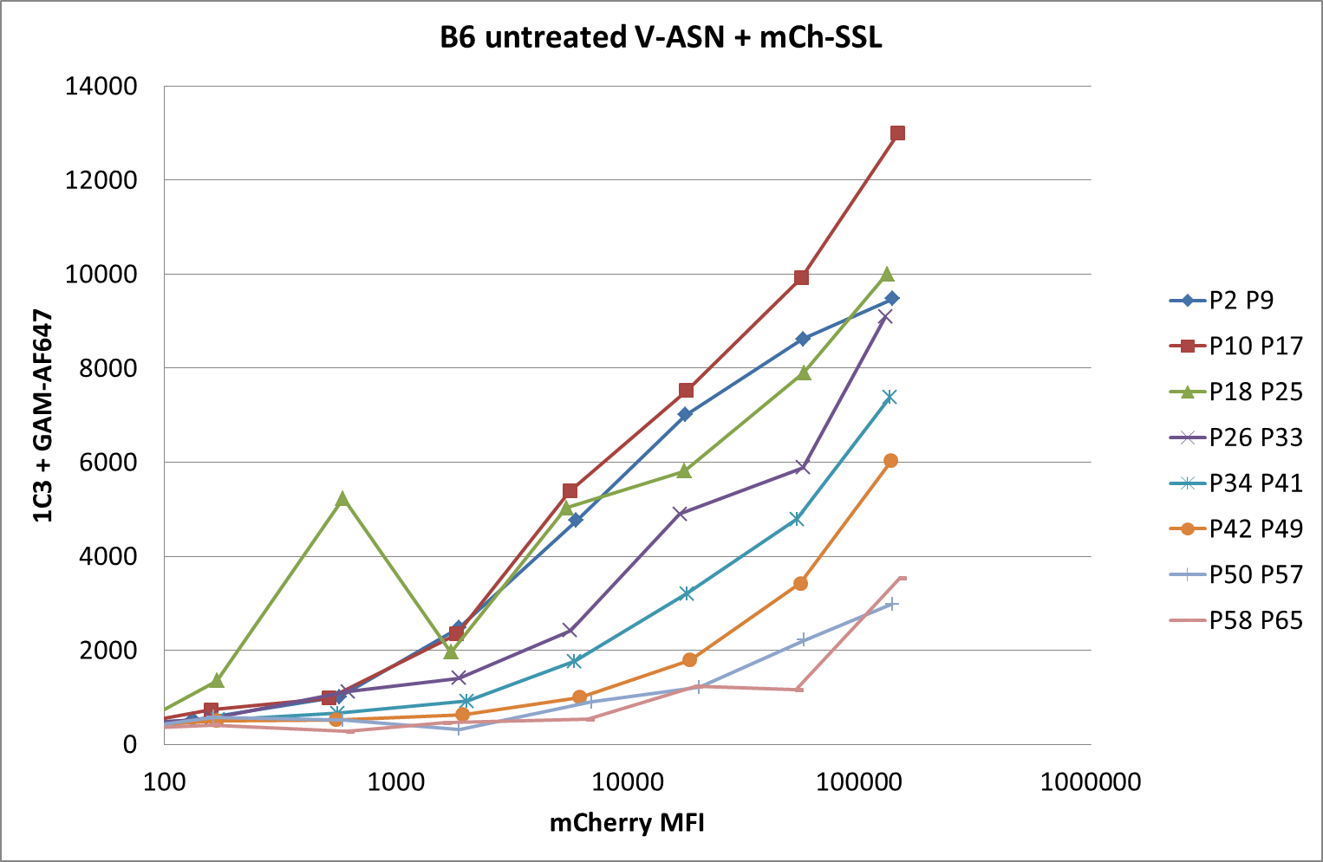
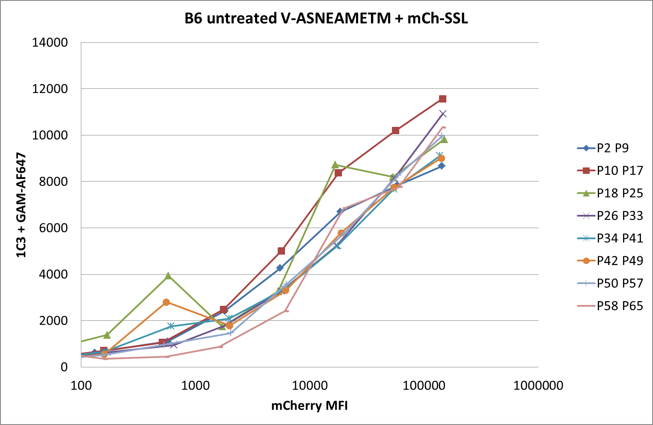
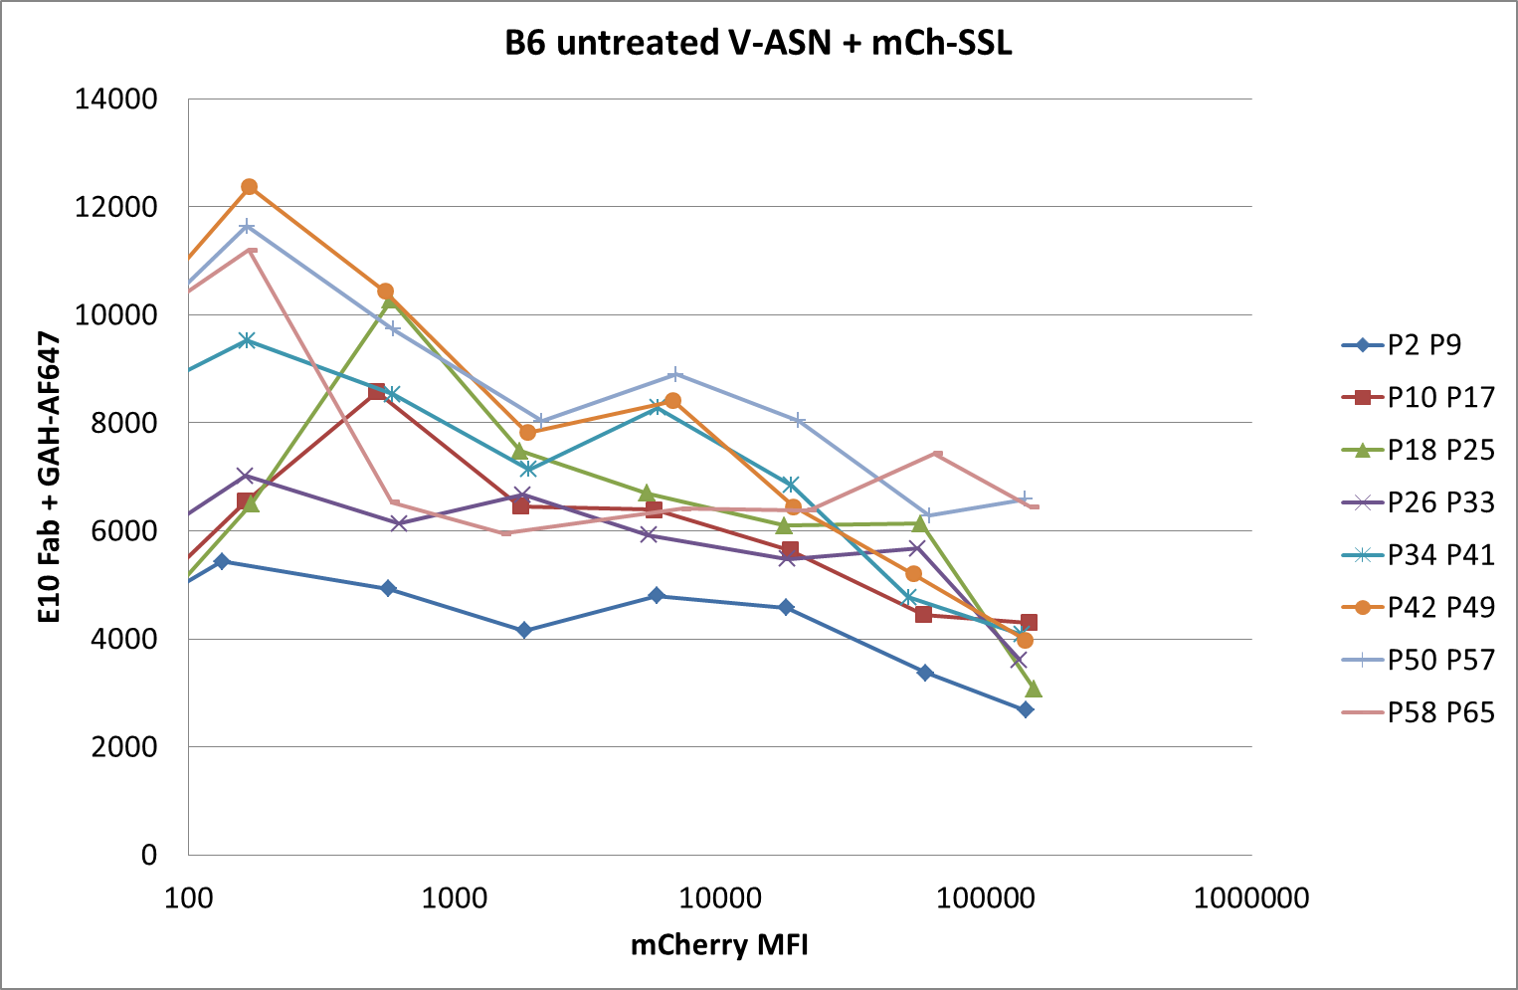
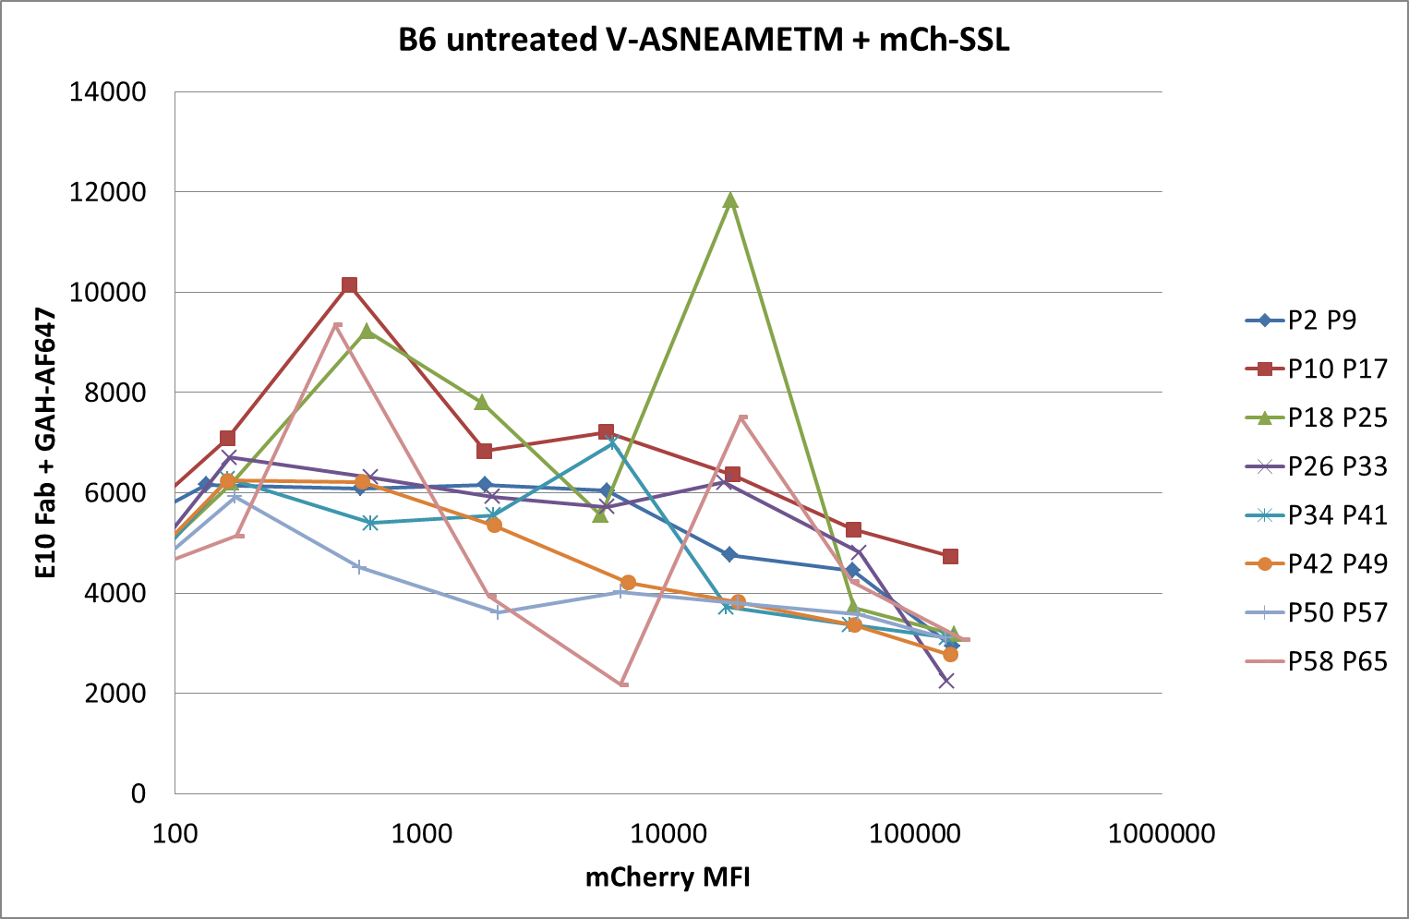
150812 pMHC competition
V-ASN or V-ASNEAMETM / mCh-SSL
007
011
010
014
Notes:
Sent 13/08/2015

